Slide 1
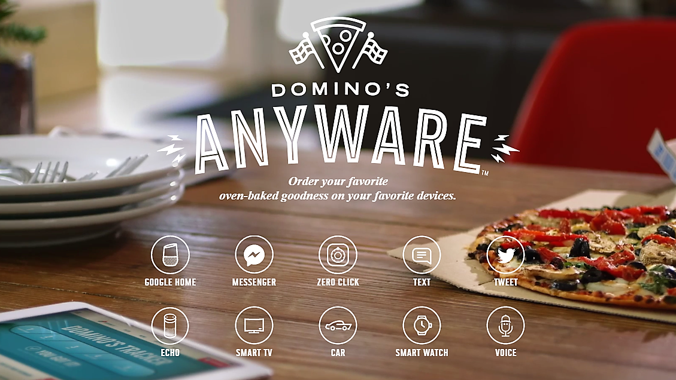

Domino’s Tweet Ordering
Analysis of conversion, and timing of the first order

Slide 2
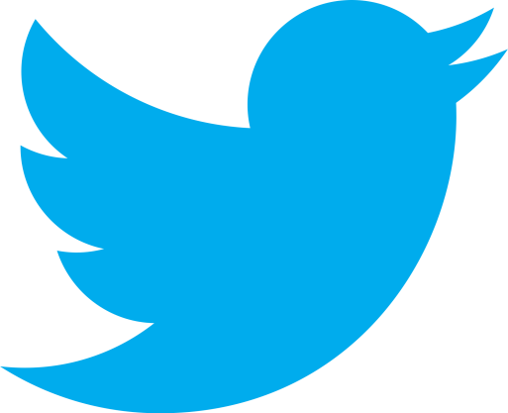
Dataset Overview
302 tweets collected from Twitter’s API with the search query “@dominos #EasyOrder”
Tweets were from the previous 6.3 days from the time of data collection

Slide 3
Notes:
Approximately 4% of new Tweet Order activations placed an order within 6.3 days of the activation.

Slide 4
Notes:
Of the customers that placed an order within 6 days of activating Tweet Ordering, 90% of them placed their first order within 1 DAY of activation.

Slide 5
Notes:
More specifically, of the customers that placed an order within 6 days of activating Tweet Ordering, 80% of them placed their first order within 1 HOUR of activation.

Slide 6
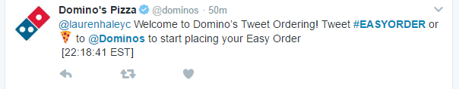
Goal
Increase the number of “first orders” placed by newly activated Tweet Ordering customers
Tweet Ordering
activated
“First Order”

Slide 7
Possible Tests
Increase conversion with different promotions
Increase conversion by reengaging the newly activated Tweet Ordering customer
Reminder tweets

Slide 8

Limitations and Future Improvements
Original data did not include results for tweeted orders containing “@dominos “
Talk to dev about how to search this as a URL parameter
Only contains data for 6.3 days. This is where the twitter API maxed out.
Longer would tell us if higher conversion happens at a longer duration. For example, since the customer has to first place an order online to save an Easy Order, perhaps they setup Tweet Ordering at that time and planned to use it in the future. If median frequency of purchase is 7 days the original analysis could be skewed.

Slide 9
Limitations and Future Improvements
Try alternative auto reply message after activation that says ‘hey retweet this to order!’ (but much more @dominos like ☺)
Need to pull data to support this and see how many orders were placed by retweeting the auto-reply message. I saw some users doing this during data exploration.

Slide 10
Limitations and Future Improvements
Rate limiting needs to be tested because the original API call was not high enough to hit the API limit (450 tweets per 15 minutes)
Reproducible results are a must! The raw JSON responses of the Tweets should have been downloaded and stored. Even using a max_id parameter does not solve this issue because the API only goes back 6-9 days

Slide 11
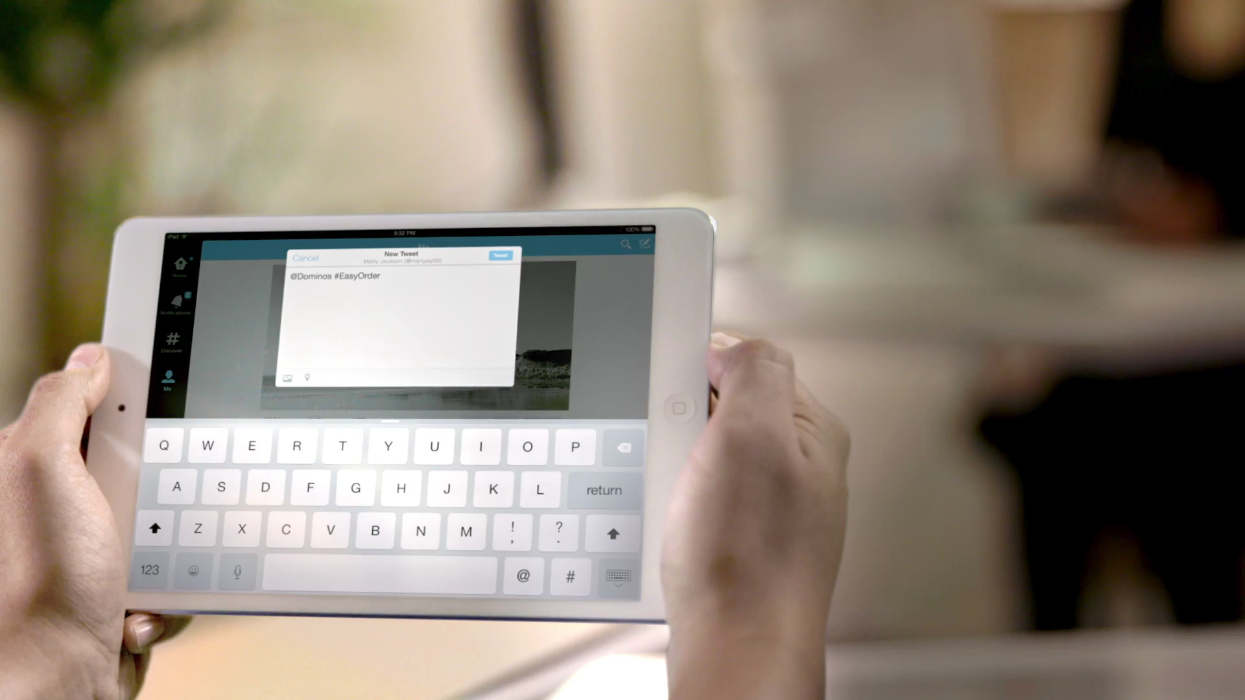
Looking Forward to Many More Presentations with @dominos!
Presentation by: Kenny Deneweth
*View as slide show to see video clip

